Slide 1
NAAN MUDHALVAN-IBM SKILL BULID
GENerative AI
Project report
NAME : S.B.HEVIN
REGISTER NUMBER : 2021506027
DEPARTMENT : INFORMATION TECHNOLOGY
COLLEGE : ANNA UNIVERSITY-MIT CAMPUS

Slide 2
TITLE: GANime-Generating Anime with GANs.
Overview of GANs:
Introduction to Generative Adversarial Networks (GANs) and their role in creating realistic anime images.
GANime Project:
Objective: To generate high-quality anime-style images using GANs.
Dataset: Collection of anime images for training.
Model Architecture: Description of GAN architecture used.

Slide 3
GANime-Generating Anime with GANs.
Introduction to Generative Modeling
Deep neural networks typically used for supervised learning.
Generative Adversarial Networks (GANs) focus on generative modeling, an unsupervised learning task.
Definition of generative modeling: discovering patterns in data to generate new examples.
Example of Generative Models
Mention thispersondoesnotexist.com, showcasing generated images of people's faces.
Highlight the fascinating results of generative modeling.
Approach of Generative Adversarial Networks (GANs)
Two neural networks involved: Generator and Discriminator.
Generator produces fake samples from random input; Discriminator distinguishes real from fake.
Training process involves alternating between training the Discriminator and the Generator.

Slide 4
GANime-Generating Anime with GANs.
Challenges with GANs
Notorious difficulty in training GANs.
Sensitivity to hyperparameters, activation functions, and regularization techniques.
Objective
Train a GAN to generate images of anime characters' faces.
Utilize the Anime Face Dataset containing over 63,000 cropped anime faces.

Slide 5
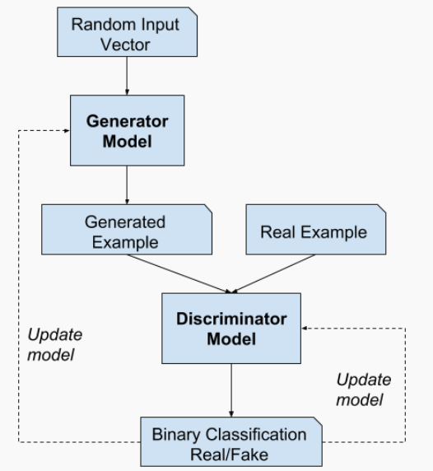
GANime-Generating Anime with GANs.
Two Neural Networks:
•Generator:
Generates "fake" samples.
Input: Random vector/matrix.
•Discriminator:
Differentiates between "real" and "fake" samples.
Input: Sample (real or generated).

Slide 6
GANime-Generating Anime with GANs.
Discriminator Network:
Input: Image (real/generated).
Objective: Classify as "real" or "generated".
Architecture: CNN.
Output: Single number per image.
Reduction: Stride of 2 for downsampling.
Layers: Convolutional, pooling, fully connected.
Activation: Typically ReLU or Leaky ReLU.
Loss: Binary cross-entropy.
Training: Adversarial with generator.
Output Interpretation: Values near 1 = real, near 0 = generated.

Slide 7
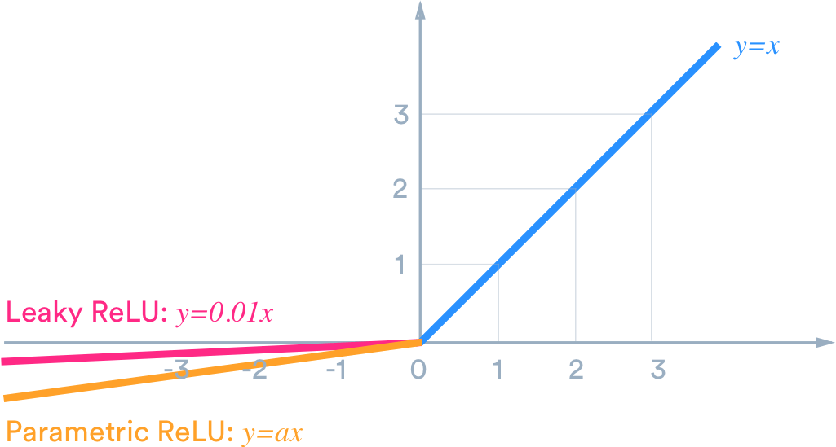
GANime-Generating Anime with GANs.
Leaky ReLU Activation in Discriminator
Activation: Leaky ReLU utilized.
Purpose: Prevents gradient saturation.
Advantage: Addresses vanishing gradient issue.
Effectiveness: Enhances discriminator's learning capability.
Training Stability: Contributes to GAN training stability.
Improved Performance: Results in more reliable discriminator output.
Common Choice: Widely adopted in GAN architectures.

Slide 8
GANime-Generating Anime with GANs.
Generator Network
Input: Latent tensor (vector/matrix of random numbers).
Purpose: Seed for generating an image.
Latent Tensor Shape: Typically (128, 1, 1).
Output: Image tensor shape: 3 x 28 x 28.
ConvTranspose2d Layer: Utilized for conversion.
Operation: Transposed convolution (deconvolution).
PyTorch Module: Integrated into the generator architecture.
Functionality: Upsamples latent tensor to image tensor size.
Role: Essential for transforming random noise into meaningful images.
Training Impact: Crucial for GAN's generative process.
Architecture Integration: Integral part of the generator's architecture.

Slide 9
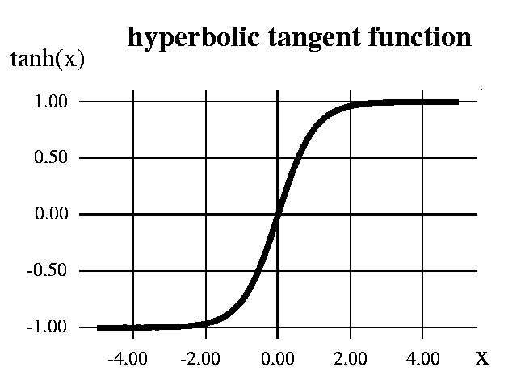
GANime-Generating Anime with GANs.
TanH Activation in Generator Output Layer
Activation Function: TanH utilized for output layer.
Purpose: Scales output to range [-1, 1].
Output Range: Ensures compatibility with image data.
Advantage: Prevents saturation of gradients.
Stability: Contributes to stable training of GAN.
Common Practice: Widely adopted in GAN architectures.
Output Characteristics: Ensures realistic image representation.
Final Layer Operation: Applies TanH activation to final generator layer.
Impact: Crucial for generating high-quality images.

Slide 10
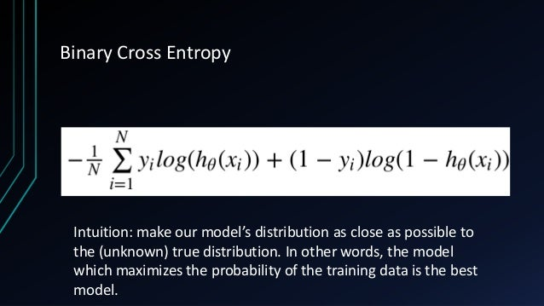
Title and Content Layout with Chart
GANime-Generating Anime with GANs.

Slide 11
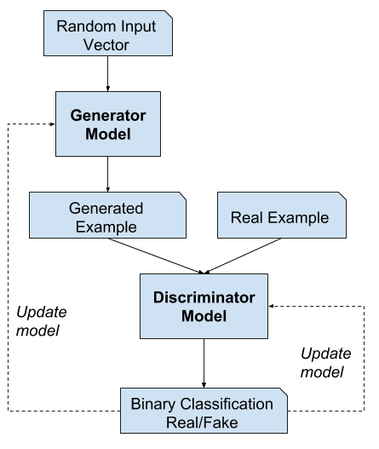
GANime-Generating Anime with GANs.
FULL
TRAINING LOOP

